Slide 1

Woolaston Primary School
Parent Guide - Mathematics

Slide 2
Current Teaching Methods
The way that maths is taught now can greatly differ to how most adults were taught in school.
Some parts may be familiar, but a lot has changed.
We know that lots of parents and carers can find it challenging to support their child with maths; this guide will hopefully give you some support with this.

Slide 3
Aims for this guide:
To gain an understanding of each year groups expectations
To get an insight into how maths is taught at Woolaston Primary School
To give you some ideas of how you can support your child at home with maths

Slide 4
Attitudes towards maths
The best thing that parents and carers can do for children is to have a positive attitude towards maths. Avoid phrases like "I can’t do maths" or "I hated maths at school"; your child might start to think like this themselves.
Point out the maths in everyday life. Include your child in activities involving maths such as using money, cooking and travelling.
Praise your child for effort rather than talent - this shows them that by working hard they can always improve.

Slide 5
Each year groups expectations
At school, your child is taught the National Curriculum
The National Curriculum began in 1989 and was most recently revised in 2014. It is a set of subjects and standards used by schools so that all children learn the same core topics.
It explains which subjects are taught and the standards children should reach in each subject.
Each year group has a road map which shows what they are learning throughout the year.

Slide 6
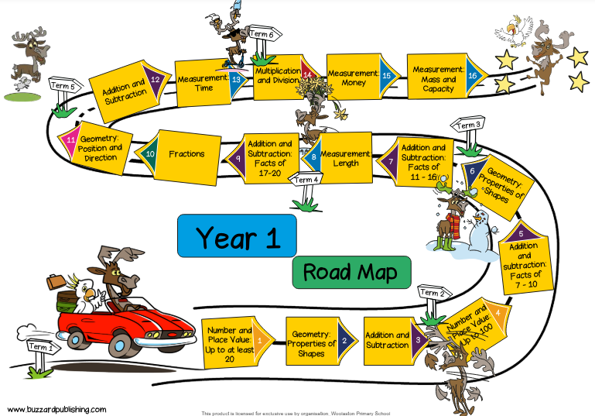

Slide 7
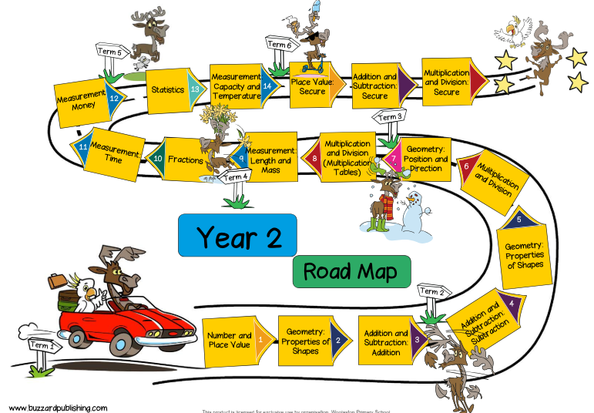

Slide 8
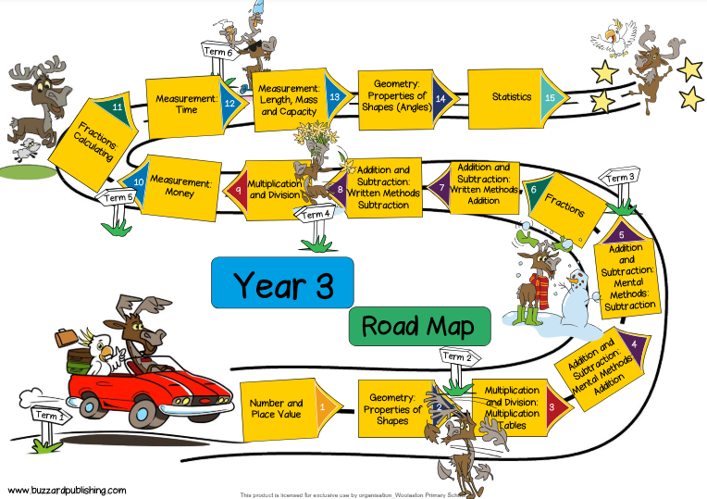

Slide 9
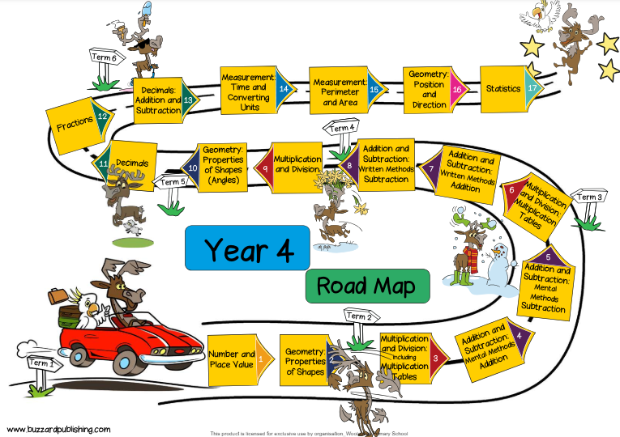

Slide 10
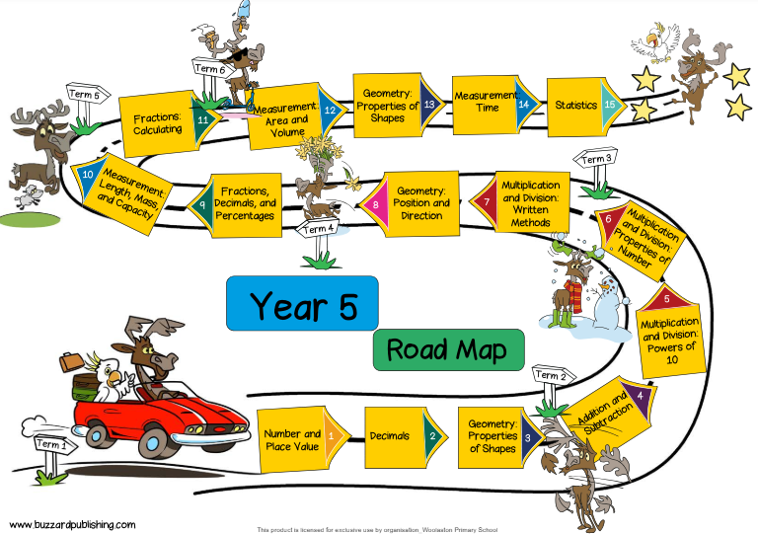

Slide 11
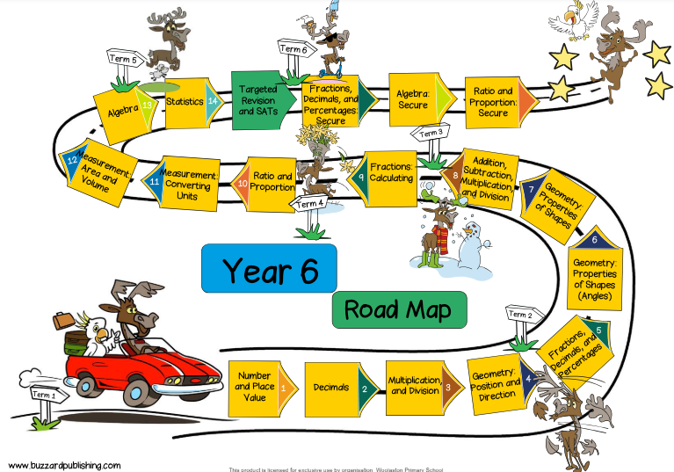

Slide 12
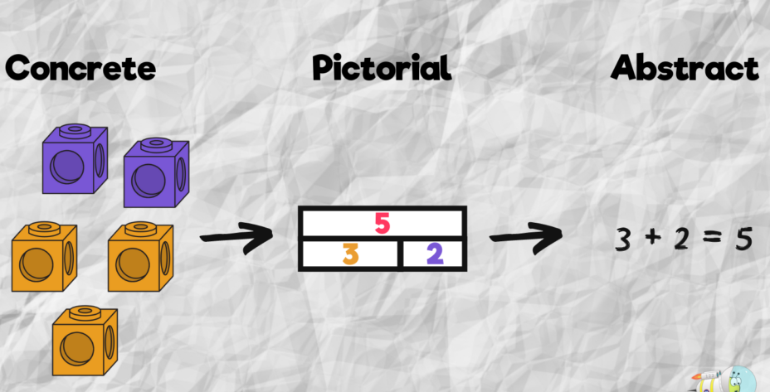
Concrete, pictorial, abstract
You may hear your child talking about how they used either manipulatives (concrete), representations (pictorial) or written methods (abstract) in their maths.

Slide 13
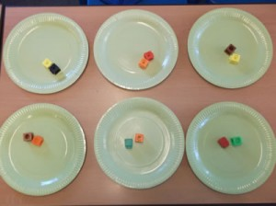
Concrete
The children are first introduced to an idea or a skill by acting it out with real objects. In division, for example, this might be done by separating apples into groups of red ones and green ones or by sharing 12 biscuits amongst 6 children. This is a ‘hands on’ approach using real objects and it is the basis for conceptual understanding.

Slide 14
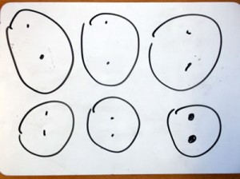
Pictorial
This is used when a child has sufficiently understood the hands-on experiences performed and can now relate them to representations, such as a diagram or picture of the problem. In the case of a division exercise this could be the action of circling objects.

Slide 15
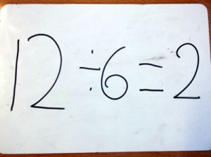
Abstract
The symbolic stage – a student is now capable of representing problems by using mathematical notation, for example: 12 ÷ 6 = 2. This is clearly the more confusing and mysterious of the three and without the ‘hands on’ and pictorial steps can be very hard for children to understand.

Slide 16
Calculation policy
The calculation policy can be seen on the next slides for year 1 (the rest of the year groups can be found on the school website). It details the way that addition, subtraction ,multiplication and division are taught at our school.
There is a clear progression from year group to year group.
At Woolaston, we only teach the strategies from their own year group, or the previous year groups. We do NOT teach strategies which are from higher year groups.

Slide 17
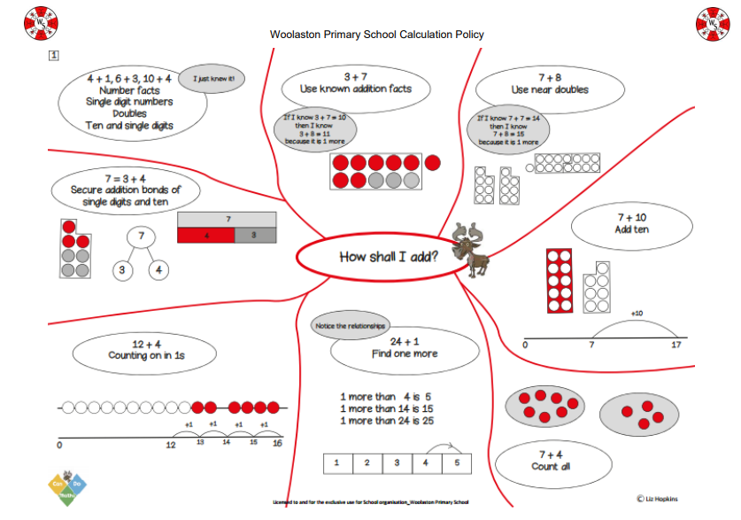

Slide 18
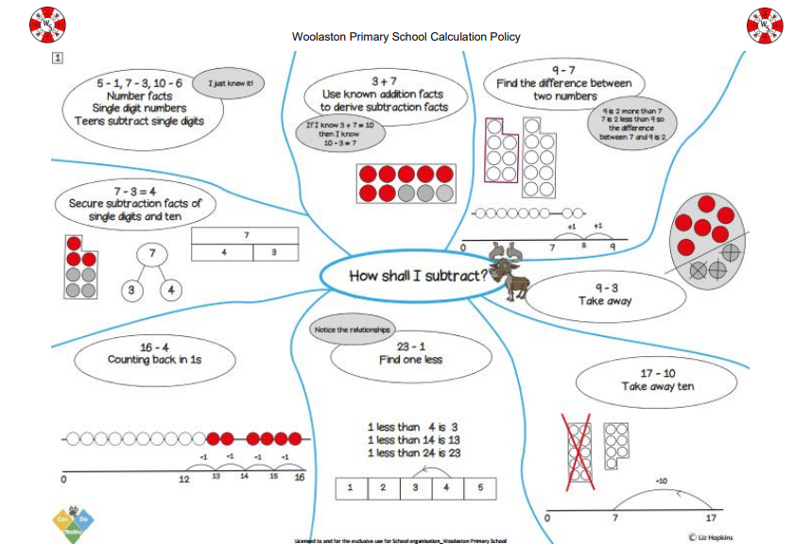

Slide 19
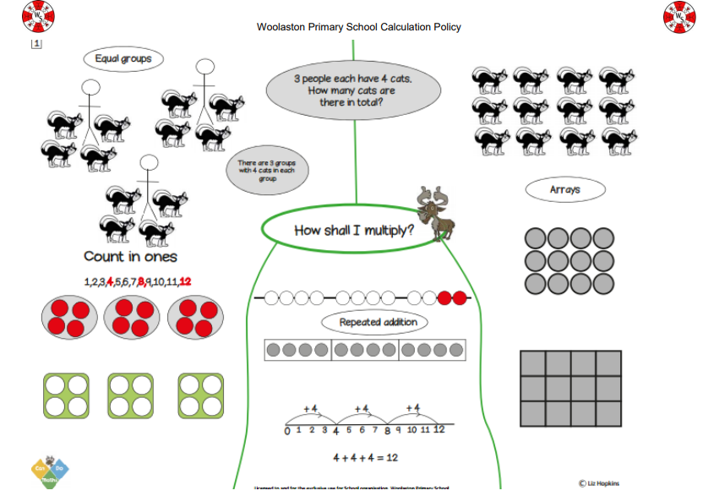

Slide 20
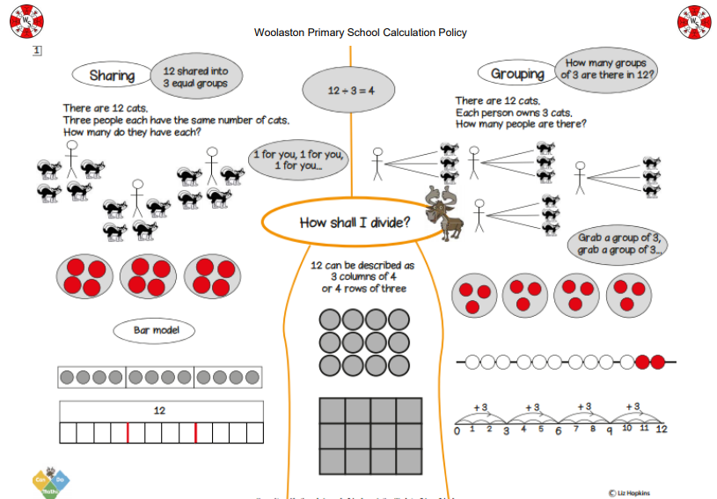

Slide 21
Homework
At Woolaston, we use a two weekly cycle for homework (one week for English, one week for Maths).
Each homework piece will link to what the children have been learning in class.
The homework is designed so that the children can access it independently. However, some children may need extra support depending on how well they have understood the unit of work.

Slide 22
Maths is everywhere
• Cooking (measurements, capacity, weight)
• TV time
• Shopping (best buys/BOGOF)
• Time
• Banking/bills
• Decorating
• Travelling
• Moving around
Gardening

Slide 23
Tips for helping your child with maths:
Measuring their height and working out how much they've grown
On car journeys - playing number-plate games, adding and subtracting with road signs, thinking about speed by dividing distance by time at the shops - weighing fruit and vegetables, budgeting with pocket money, working out the relative value of products by comparing prices and weight
In the kitchen - with weighing and measuring, and temperature and timings
Making models and origami shapes
Playing games together– jigsaws, monopoly, top trumps, match attacks cards

Slide 24
